Slide 1
The Denver Crypto Group presents our: DCG Trading Course
nov 29th, 2017
Denver Crypto Group
www.denvercryptogroup.com

Slide 2
Introduction
Matt’s BIO
Goals of the Denver Crypto Group:
Promote Diversity of Blockchain space.
Build confidence of members in explaining Blockchain.
Create an atmosphere of learning.
Support us by following our twitter!
@DenverCryptoGrp

Slide 3
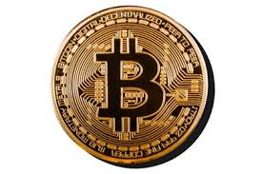
DCG Trading Course: Intro
Starting in January of 2018 the Denver Crypto Group will offer a paid Trading Course!
This course will teach our members a Foundational Trading System that they can apply to successfully trade CryptoCurrency.

Slide 4
DCG Trading Course: Intro
Our Foundational Trading System was developed by Matt, Chris, & Mike who all have extensive trading experience.
Using this system Chris tripled his portfolio value in 3 months!
Matt saw a 10x return over 8 months with a less refined version of this system.

Slide 5
DCG Trading Course: Intro
Upon completion of the DCG Trading Course members will:
Know how to minimize their risk when trading.
Know how to create opportunity for themselves in a Bull or Bear market.
Fully understand multiple Technical Analysis Indicators and how they affect each other & the price.
Know how to fully plan out a Buy/Sell strategy and then stick to it.

Slide 6
DCG Trading Course: Intro
The vision we followed to create the DCG Trading Course incorporates:
Teaching each member a basic Cost Averaging trading strategy that we build on throughout the course.
Adding tools to each members “Trading Toolbox” and teaching them how/when to use them.
Helping each member find their personal risk profile then develop a personalized version of our Foundational Trading System.
Not letting bad entries/exits sideline you while markets move.
Progress from a Crypto gambler to a professional Crypto Trader!

Slide 7
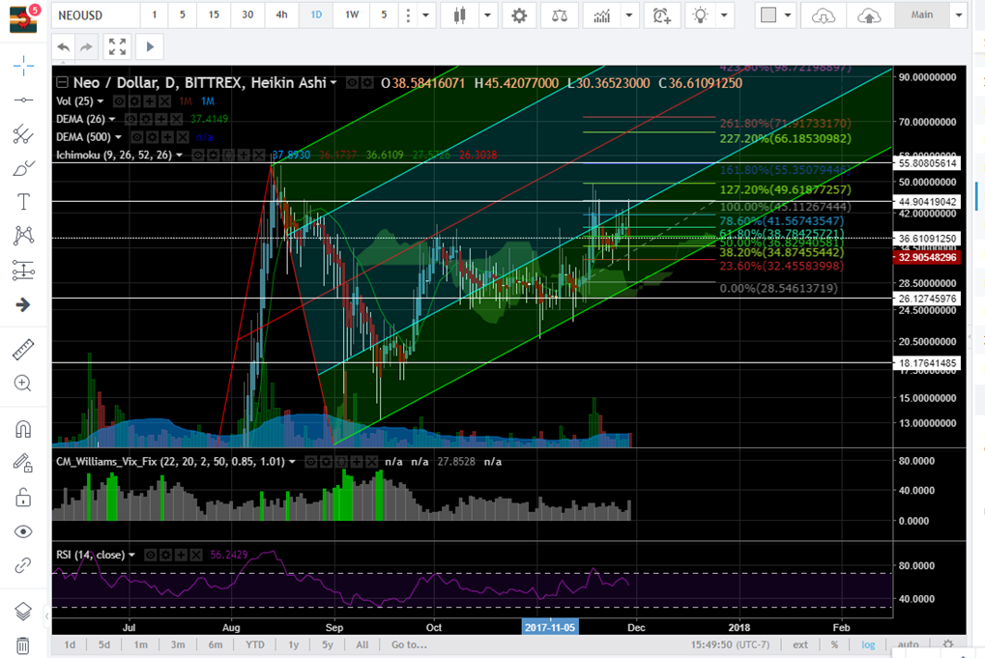
DCG Trading Course: Intro
Can you identify a good entry and exit point in the picture to the right?
If you aren’t able don’t worry! The DCG Trading Course is for you!
There will be 4 classes total with each class running 1.5 hours.
Cost is $50 for each class or $165 up front for the complete Course.
Our next meetup on Dec 13th will actually be the entire 1st class in the DCG Trading Course and it will be completely FREE!

Slide 8
DCG Trading Course: Intro
The following requirements must be met prior to attending any of the DCG Trading Course classes.
Accounts:
Coinbase account with Bank account or Credit card linked.
Bittrex account.
Trading View account.
Blockchain.info account.
2 Factor authentication on all accounts except Trading View.
Laptop/device capable of running Trading View smoothly.
We will be doing live, hands-on learning for this course so a computer will allow members to get the most out of each class.
Ability to pay for course in Bitcoin, Ethereum, Litecoin or Monero. At this time we are not accepting USD to pay for the DCG Trading Course.

Slide 9
Thank you for attending!
If you would like In-person help for anything CryptoCurrency related please talk to Matt, Mike, or Corrinne. We offer the following services:
Trader Package – Learn how to set up exchange account(s) and start trading today! We give you the tools to knowledgeably vet Currencies and information on hot Crypto’s!
Monero Mining Rig – Mines around 12 Monero (XMR) per year.
Consulting Service – Personal or Business solutions, $100/hr to sit down and resolve any issues/questions related to CryptoCurrency.
TB1 Trading resource – Participate in a great ICO while learning how to trade, ask Matt for more info. MEW wallet required.
nov 29th, 2017
Denver Crypto Group
www.denvercryptogroup.com

Slide 10
Why practicing good Blockchain Security is important.
YOU are your own bank now.
A foreign hacker who empties your Crypto wallet(s) may earn enough to live for a year or more.
You must treat the Private Key of your CryptoCurrency wallet(s) like a bank vault key!
The ability to keep your wealth securely in your own hands isn’t possible without practicing good Blockchain Security.

Slide 11
Blockchain Security Practices
The only time a Website/Program/Wallet/Whatever needs your Wallet Private Key is to authorize the movement of funds from your account.
Avoid Phishing by verifying Webpage addresses.
EX: MyEtherWallet.com is a legitimate ETH Wallet.
EX: MyEtherWallet.com/co is a Phishing site.
Keep the Private Key to your Wallet(s) offline.
Create a text document that contains a list of each Private Key for every Wallet.
Print this text document and store in a safe place.
Encrypt this text document with a unique Password.
Copy the encrypted text document to 2 USB drives. DELETE THE TEXT DOC AFTER!
Keep 1 USB in a safe location, carry 1 USB with you if daily Wallet access is required.
Buy a Trezor or Nano hardware Wallet.
Enable the Google Authenticator smartphone app on any account login to increase security.
Call your cell phone provider and have them issue a: “DO NOT PORT” order on your account. This requires verbal authorization from you to port your phone number to a new phone.

Slide 12
Recommended Wallets
Bitcoin:
Desktop – Electrum https://electrum.org/#download
Web – Blockchain.info https://Blockchain.info
Ethereum:
Desktop - GETH https://github.com/ethereum/mist/releases
Web – MEW https://MyEtherWallet.com

Slide 13
What is Blockchain doing Today?
Current Events
Alt coin rally incoming. (In my opinion)
China’s trading/ICO ban
No updates so far
Bitcoin Gold/Cash/Segwit2x

