Slide 1
Class 2: Wallet Setup & Blockchain’s Current State
Sept 13th, 2017
Denver Crypto Group
www.denvercryptogroup.com

Slide 2
Introduction
BIO
Goals of the Denver Crypto Group
Support us on Social Media!

Slide 3
What is a Bitcoin Wallet?
A “wallet” is basically the Bitcoin equivalent of a bank account. It allows you to receive bitcoins, store them, and then send them to others.
Two main types of Wallets:
Software
Web/Hosted
Today we will be reviewing how to create a Web/Hosted Bitcoin Wallet on Blockchain.info

Slide 4
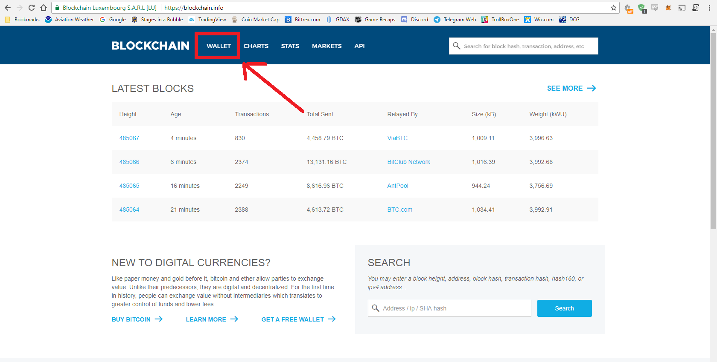
Blockchain.info Bitcoin Wallet setup…
Open https://blockchain.info/ in your internet browser.
Click on the Wallet tab in the top left of the website.
Go to https://blockchain.info
Click on “Get Started Now”
Enter your email and unique PW
Verify your email address
Print “Recovery Sheet” PDF and fill out
Enable 2-step Verification

Slide 5
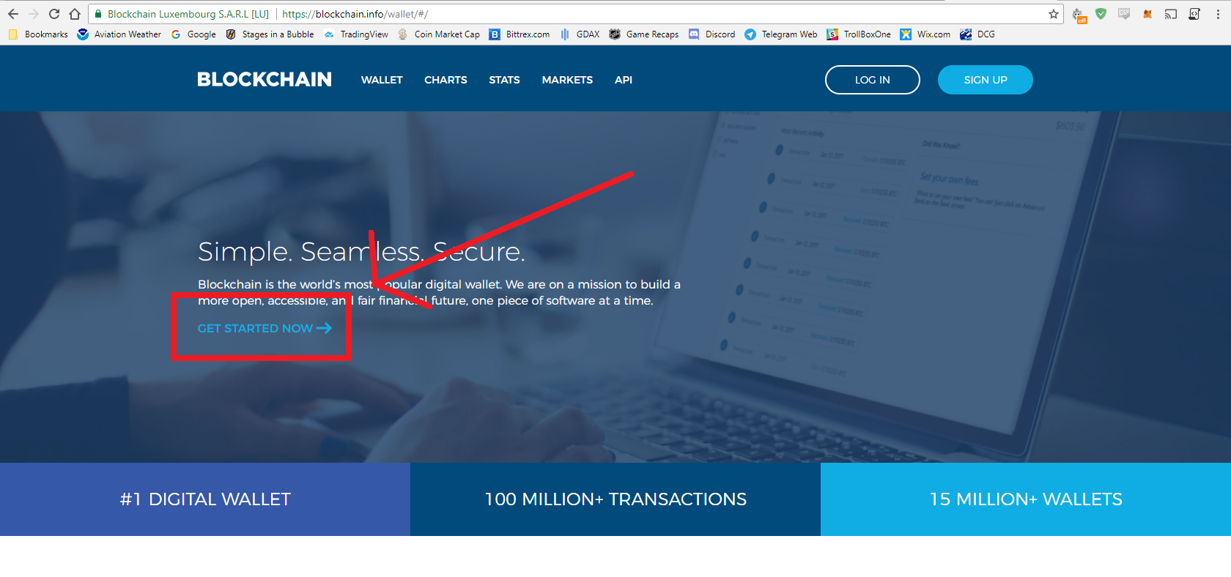
Blockchain.info Bitcoin Wallet setup…
Click on “GET STARTED NOW”
Go to https://blockchain.info
Click on “Get Started Now”
Enter your email and unique PW
Verify your email address
Print “Recovery Sheet” PDF and fill out
Enable 2-step Verification

Slide 6
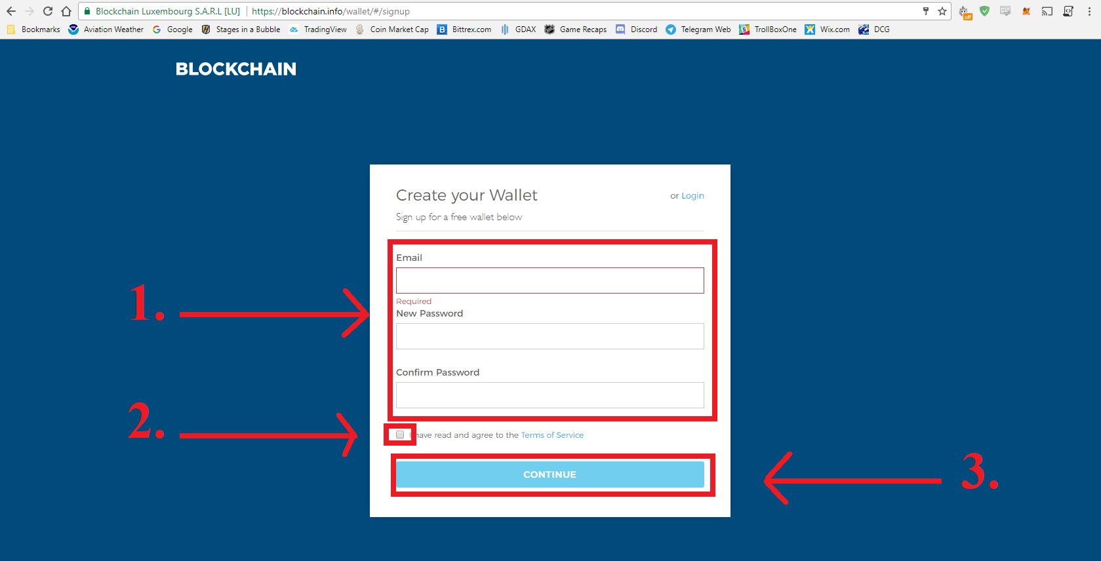
Blockchain.info Bitcoin Wallet setup…
Fill in your email address & create a unique password. Re-enter the same password.
Check the box to agree to the TOS.
Press the CONTINUE button.
Go to https://blockchain.info
Click on “Get Started Now”
Enter your email and unique PW
Verify your email address
Print “Recovery Sheet” PDF and fill out
Enable 2-step Verification

Slide 7
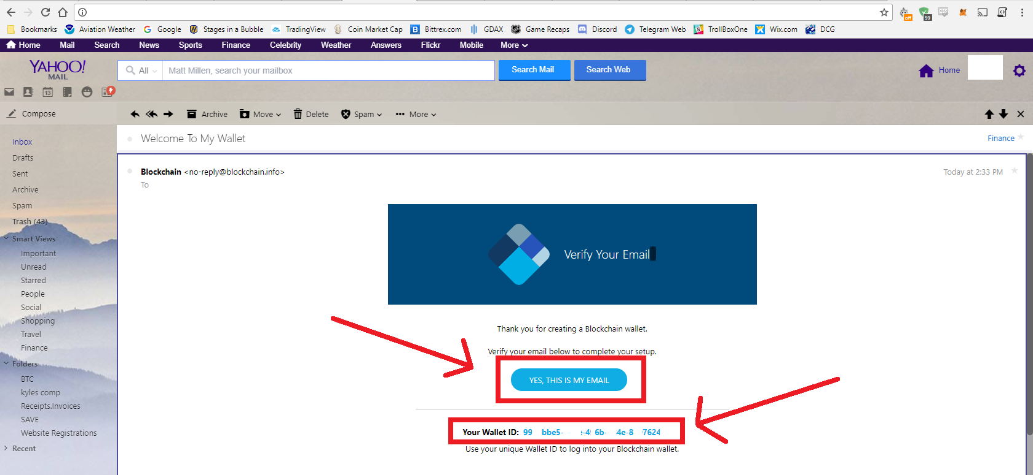
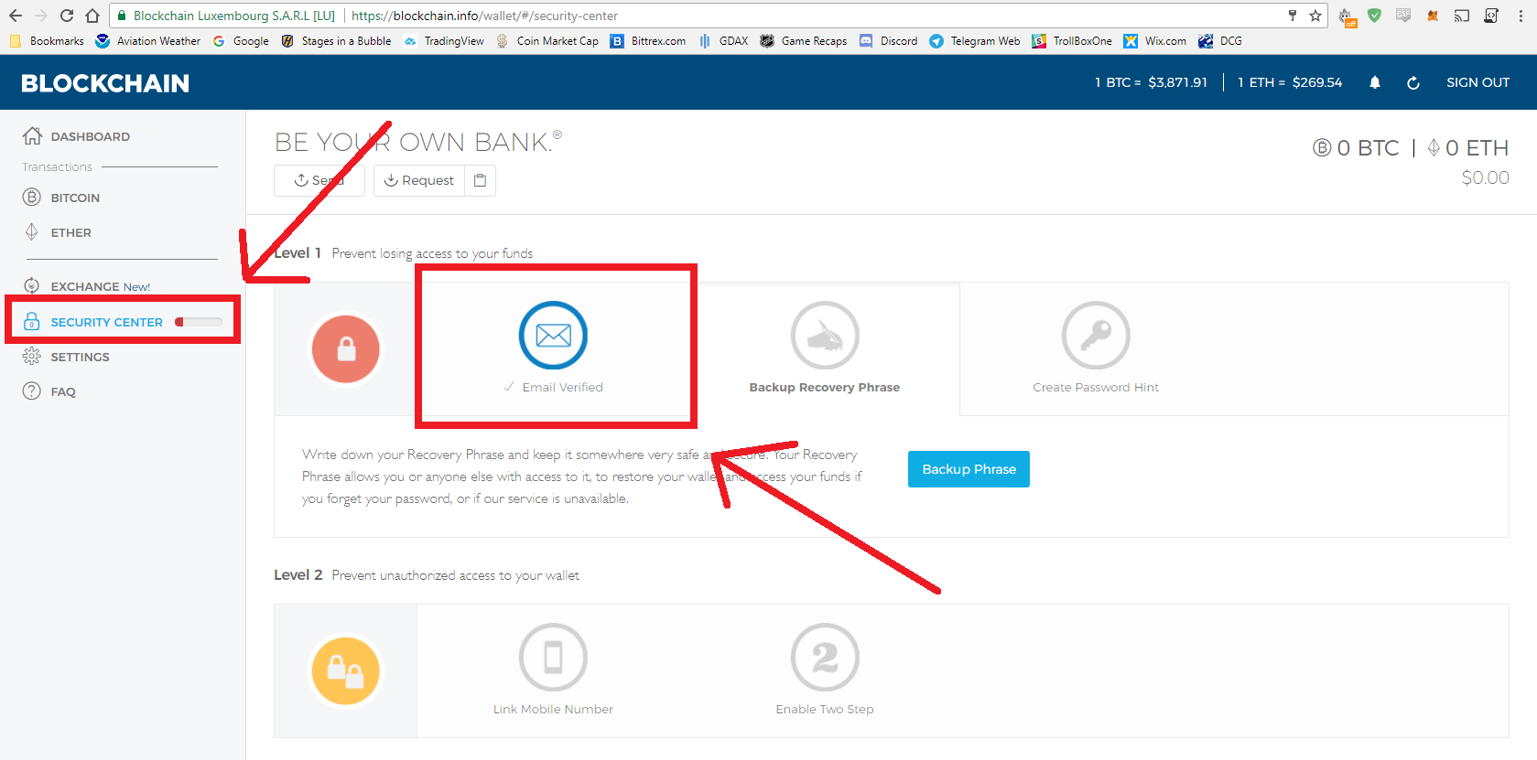
Blockchain.info Bitcoin Wallet setup…
Check your email and Verify your Blockchain.info account via the button in the email.
Physically write down your Wallet ID and Password. Wallet ID is included in this email.
Go back to https://blockchain.info. Click on “Security Center” and check that your email has been verified.
Go to https://blockchain.info
Click on “Get Started Now”
Enter your email and unique PW
Verify your email address
Print “Recovery Sheet” PDF and fill out
Enable 2-step Verification

Slide 8
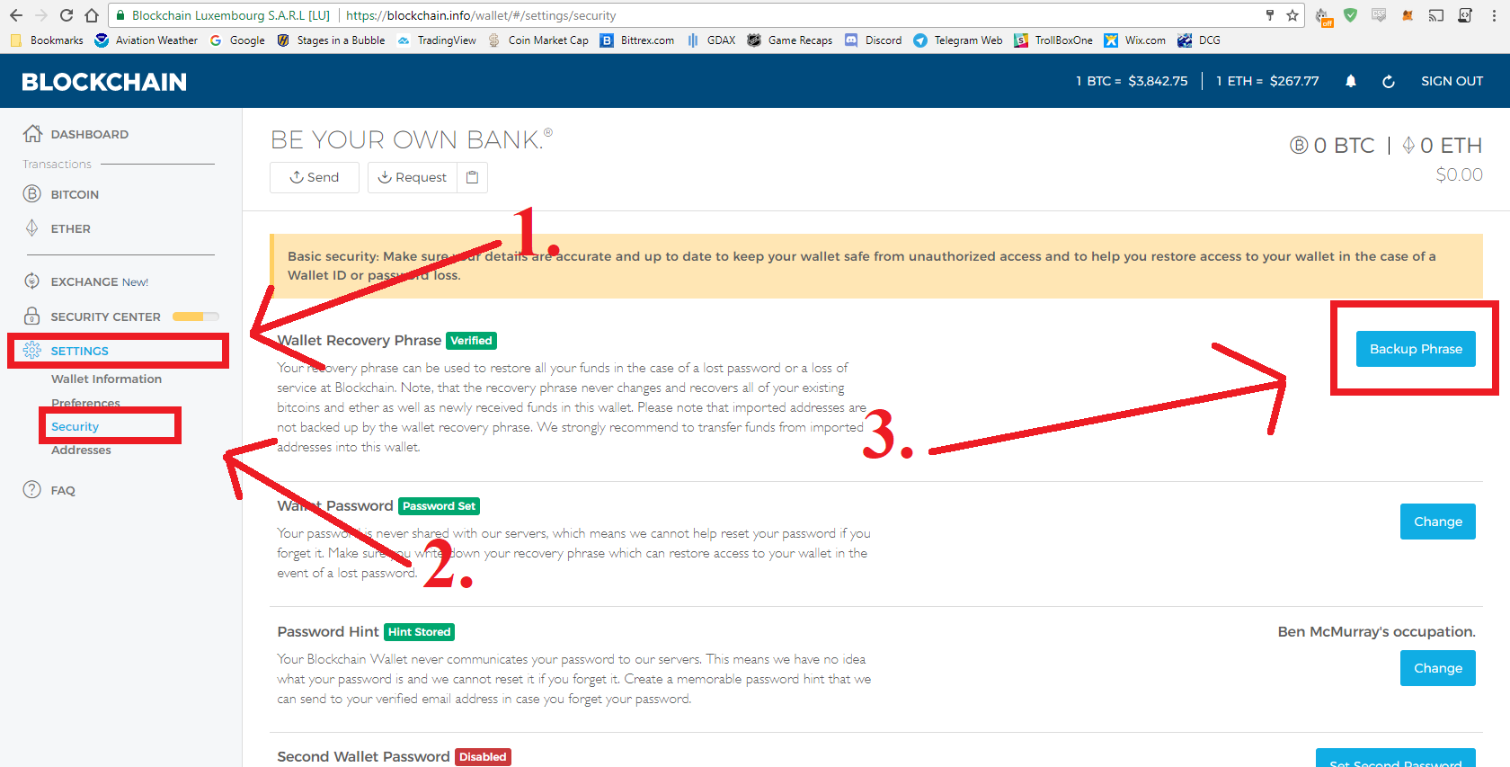
Blockchain.info Bitcoin Wallet setup…
On the far left, click “Settings” then click on “Security”.
After clicking on “Security”, click on “Backup Phrase”.
Go to https://blockchain.info
Click on “Get Started Now”
Enter your email and unique PW
Verify your email address
Print “Recovery Sheet” PDF and fill out
Enable 2-step Verification

Slide 9
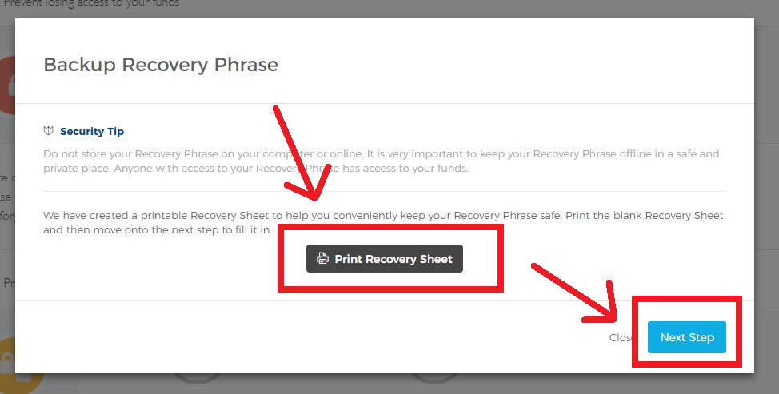
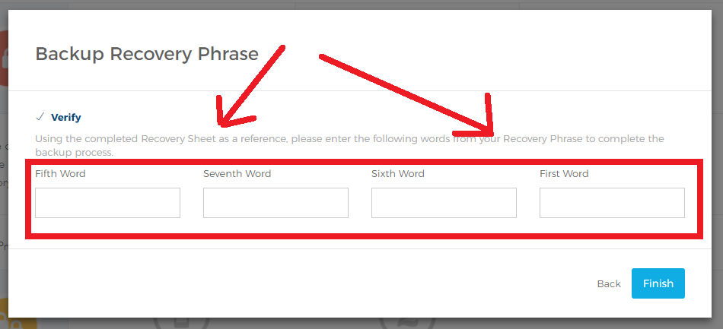
Blockchain.info Bitcoin Wallet setup…
Download and Print the “Recovery Sheet” PDF. Click on “Next Step”.
Write all 12 words in numerical order onto the “Recovery Sheet” paper.
Enter the requested words and click on “Finish”.
Go to https://blockchain.info
Click on “Get Started Now”
Enter your email and unique PW
Verify your email address
Print “Recovery Sheet” PDF and fill out
Enable 2-step Verification

Slide 10
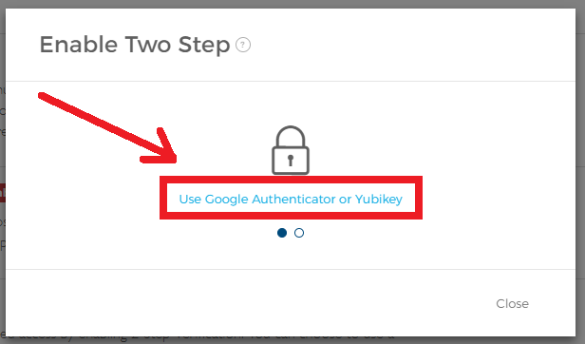
Blockchain.info Bitcoin Wallet setup…
Again, click on “Settings” and then click on “Security”.
Scroll down to “2-step Verification” and click on “Enable”.
Choose which method you wish to use (Google Authenticator is my recommendation), then click on the blue text to start setup.
Complete the instructions.
Go to https://blockchain.info
Click on “Get Started Now”
Enter your email and unique PW
Verify your email address
Print “Recovery Sheet” PDF and fill out
Enable 2-step Verification

Slide 11
Blockchain.info Bitcoin Wallet setup…Complete!
If you’ve successfully completed all 6 steps you now own a:
Bitcoin Wallet
Ethereum Wallet
You are the only person with access to these wallets as long as the following are only known to you:
Wallet Password
12 Word Recovery Phrase
Access to your Mobile Phone

Slide 12
What is Blockchain doing Today?
Current Events
Bitcoin price is down
JP Morgan CEO
China’s ICO ban
Licensing now required
ICO Regulation in the USA
Ethereum
Raiden Network

Slide 13
Thank you for attending!
If you would like In-person help for anything CryptoCurrency related please talk to Matt, Mike, or Corrinne. We offer the following services:
Trader Package - Get set up on an exchange and start trading today! We give you the tools to knowledgeably vet Currencies and information on hot Crypto’s!
Monero Mining Rig – Mines 11.67 Monero (XMR) per year.
Consulting Service - $50/hr to sit down and resolve any issues/questions related to CryptoCurrency.
Sept 13th, 2017
Denver Crypto Group
www.denvercryptogroup.com

